Slide 1
Project Earworm
Trevor Howat: SWENG-861
Notes:
Hello, My name is Trevor Howat, and this is my course project for Software Engineering 861: Project Earworm

Slide 2
Agenda
Project Outline
Design and Process
Challenges and Opportunities
Demonstration
Notes:
In this presentation, I will discuss the outline for the project, the design and process I went through when planning this project, the challenges and opportunities I faced while making the project, and a demonstration of the final product at the end.

Slide 3
Project Outline
Earworm: A catchy tune that gets stuck in your head
Software allows users to look up Songs and Artists using Spotify’s music library
Displays the results in an easy to read table
Notes:
Project Earworm is a music lookup software that allows the user to search Songs and Artists. The name Earworm refers to a catchy tune that gets stuck in your head, and I thought it would be a fun name for the software. The software utilizes the vast music library and API of Spotify. Users search in a UI and the results are displayed on an easy to read table.

Slide 4
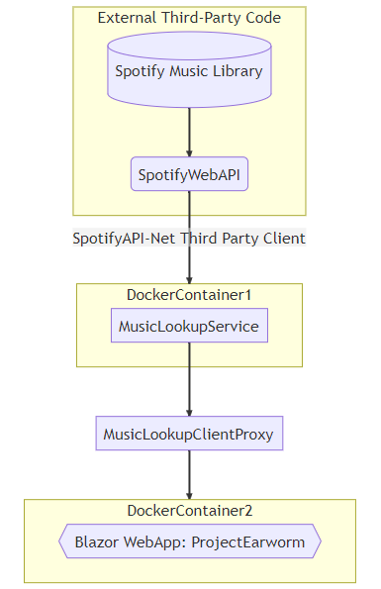
Design and Process
Tools:
Backend is written in .NET (C#)
Frontend is Blazor
Backend service calls the SpotifyWebAPI
A helper library called SpotifyAPI-NET is used to make the calls.
Tests are written using NUnit Standards
Service and Web UI are deployed on Docker
Github is used for Version Control
Notes:
When planning the project, one of the first decisions I made was to use the C# language, as I have about 18 months experience using C# to make both frontend web apps and backend web services in my career as a software engineer. While building these from scratch is still new, I figured it would help if I at least chose a base language where I had done similar work.
The frontend is in Blazor, a web application image that allows you to imbed C# code into HTML.
The backend is built off of the Spotify web API, and my local service uses a FOSS library called SpotifyAPI-NET to connect to and call the Spotify Web Service.
Both Unit tests and Integration tests are written in C# using Nunit standards.
The Service and Web UI are also deployed as docker images and run on docker containers.
For version control, I used Github.
As you can see in the diagram, the database and web API that accesses it is Spotify’s external library and API. I have build a local web service that calls the SpotifyWebAPI using SpotifyAPI-NET and runs in a docker container. There is a middle layer client proxy that calls my local service and returns formatted responses to the front end web app, which runs in a second docker container.

Slide 5
Challenges and Opportunities
Difficulties with Docker
Stretch goals were not reached
Tests could be more robust
Frontend is not the prettiest
Opportunities:
Search for albums
CI/CD Pipeline
Configuration
More detailed results
Notes:
While building the project, I ran into many challenges and opportunities. Docker proved to be far more of a challenge than I anticipated. While I was familiar with the concept of docker, I had never used it before. The amount of time spent trying to work out the kinks of docker was far greater than I expected, and this threw off my scheduled plan. I had to pivot to try and simply get the minimum viable product and then enhance from there. As a result, stretch goals were not reached, tests are not as robust as I wanted, and the frontend is not as nice looking as I had hoped.
The frontend also proved a challenge in its own right as I have more experience in backend work, and hooking the frontend to the backend was particularly difficult. Luckily, I was working in a language I was familiar with, and encountered some errors I had seen before and knew how to fix. (Opportunity to show code for Task.Run)
Despite the challenges, I am grateful I took on technologies I was unfamiliar with. Working through the issues with docker left me with a far greater understading of how it works, and it is already paying off in my career at work, as I am using Docker the new project I am with. There are also further opportunities that are set up should I continue to work on this project as a learning exercise. These future opportunities include Searching for albums, creating a CI/CD Pipeline, adding configuration for the service, rather than a hardcoded url, and creating more detailed display of results on the frontend.

Slide 6
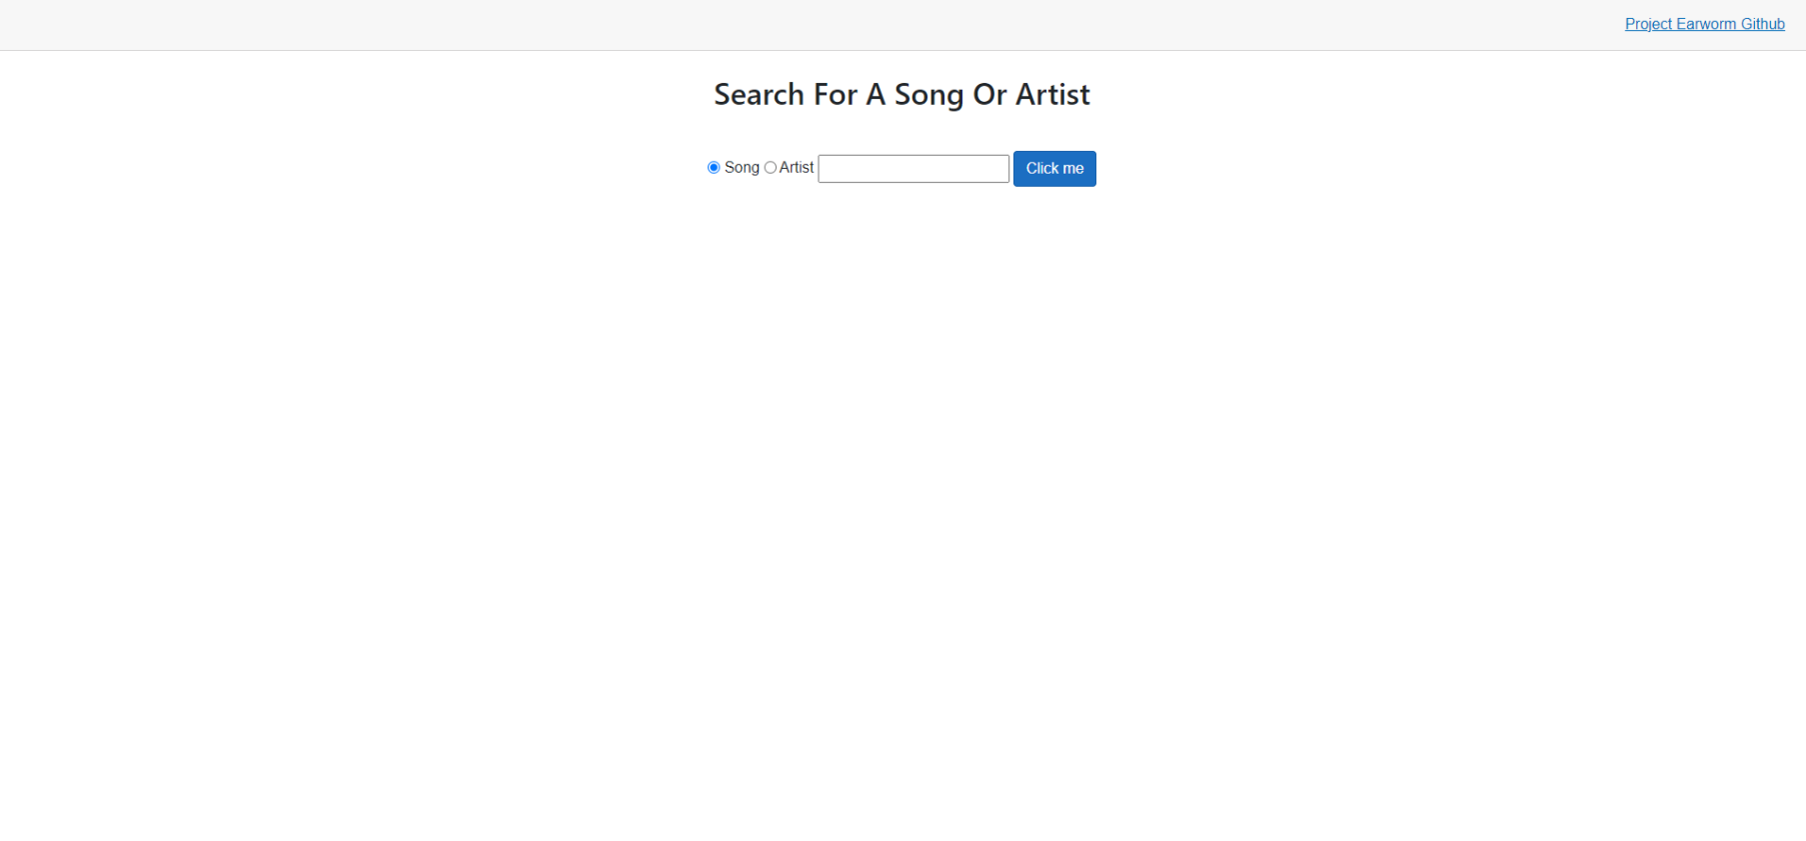
Demo!

Slide 7
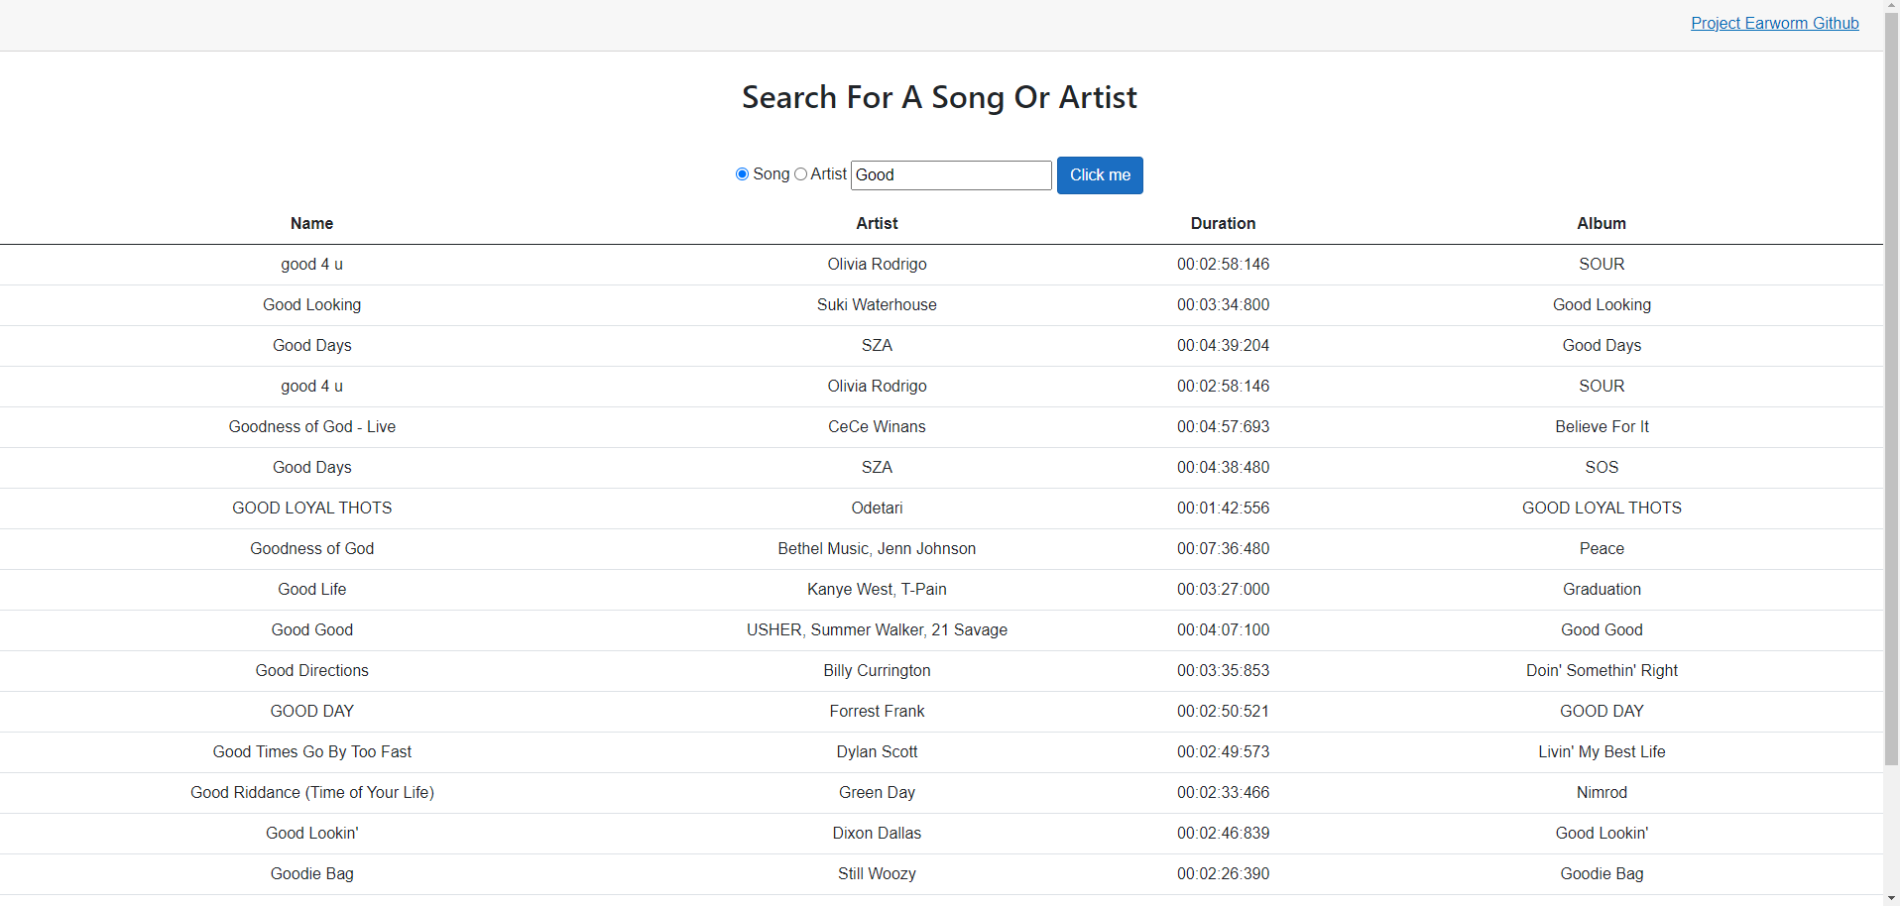
Demo: Song Search

Slide 8
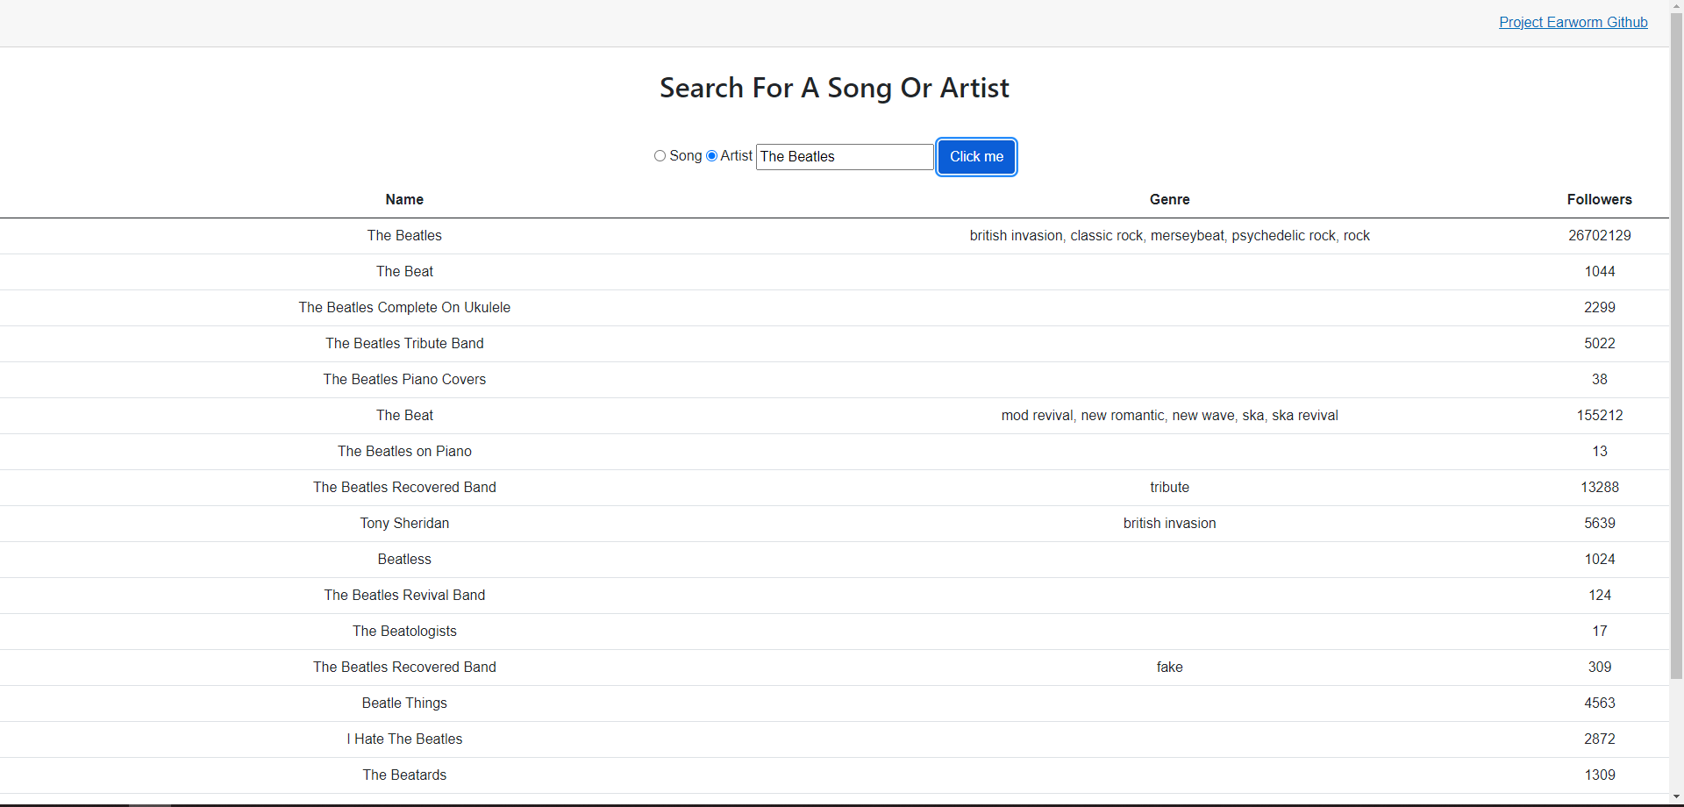
Demo: Artist Search

Slide 9
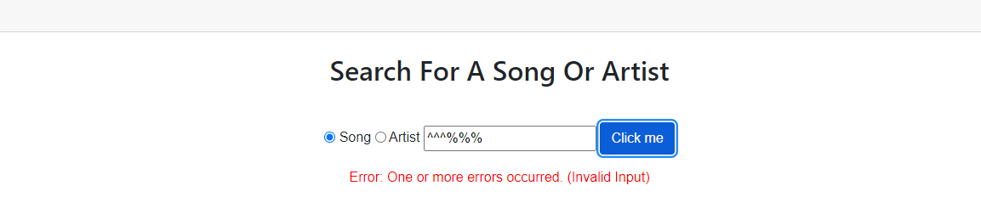
Demo: Bad Input

Slide 10
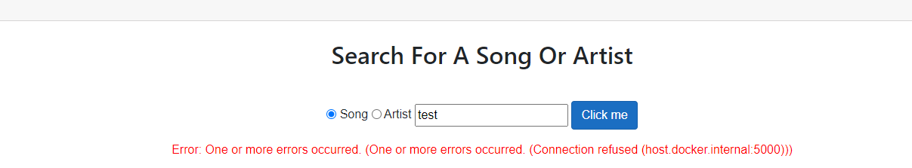
Demo: Service Error

Slide 11

Lessons Learned
Notes:
The biggest lesson I learned through this project is despite detailed planning, things can still go wrong. The planning stage turned out to be the most difficult part of the project, and I underestimated how long many steps would take me, causing me to fall behind. I relied on my experience working with frontends and web services in C#, but when it came time to create them, I realized that I had never worked on one from scratch, so much of the initial setup was foreign to me. I also could not reference other areas of a large code base like I can at work. Existing code did not exist, as this was being started from scratch. I do not regret the choices I made for the structure of the project, I just wish I had provided myself more time to work out the kinks early on, so I could fully flush out the tests and final product in the end.

Slide 12
Thank you!

